Slide 1

Credit Card Fraud Detection Using Machine Learning
Shogan Tanya
Nov 2025 , Class DS20

Slide 2

Project Overview
Project Goal :
Build a robust machine learning model that can accurately detect fraudulent credit card transactions.
Challenges:
Fraudulent transactions are rare, making this a highly imbalanced classification problem that requires careful handling to achieve satisfactory performance.
Success Factors:
Maximize recall and precision for the fraud class to improve detection reliability.
Metrics:
F1-Score, Precision, Recall, AUC.
Research Question:
Which machine learning model provides the most effective
and reliable detection of fraudulent credit card transactions?

Slide 3
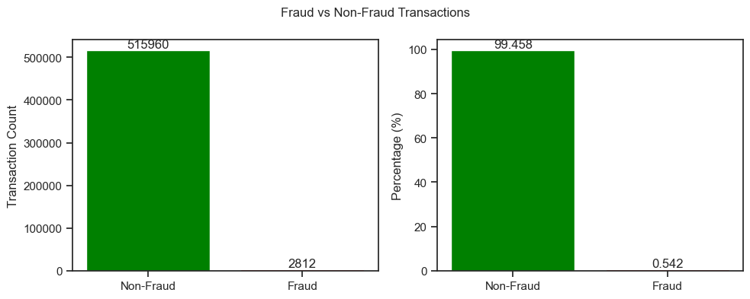
Dataset Overview
Aspect | Description
Main Dataset | Credit_card_fraud.csv • ~34M records × 26 features (transactions, merchants, timestamps, locations, customer IDs, fraud flags)
Supplementary Data | Customers.csv • ~20K customer profiles with additional metadata
Time Period | 2020- 2019
Data Quality | • No nulls • No duplicates
Target Variable | is fraud → 1 for fraud, 0 for legitimate
Class Distribution | Highly imbalanced - only ~0.5% fraud cases

Slide 4
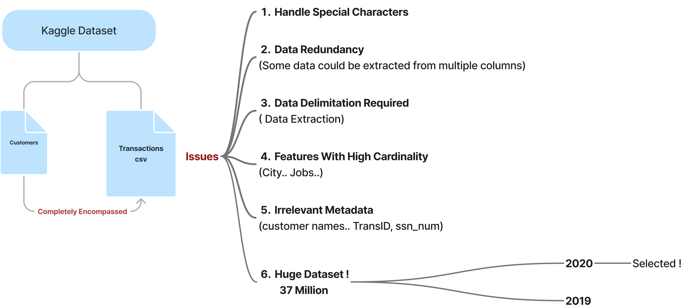
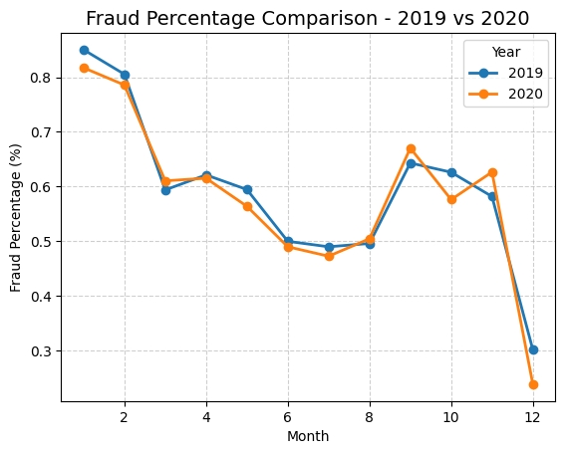
Dataset – Key Challenges

Slide 5

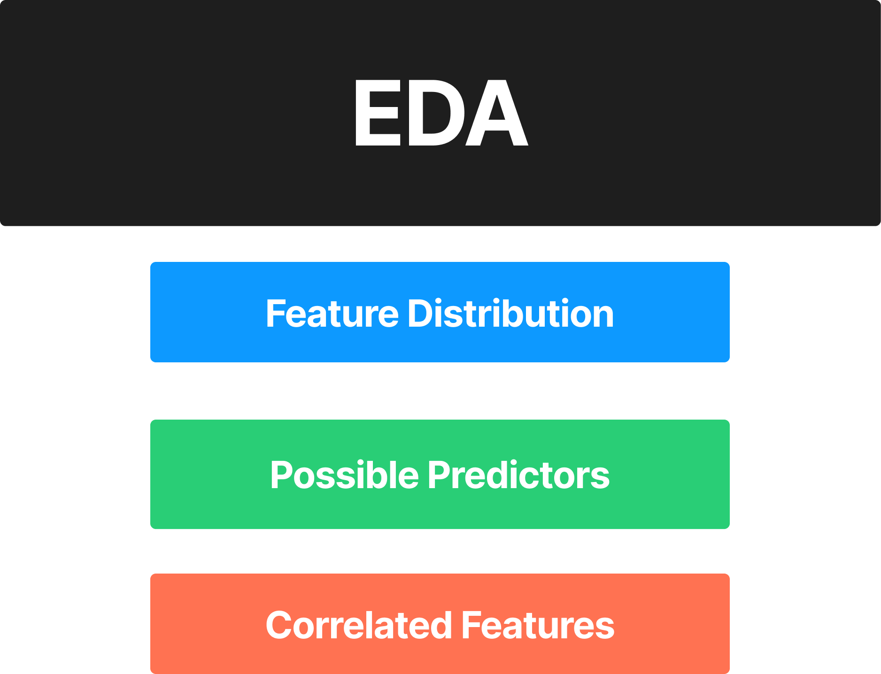
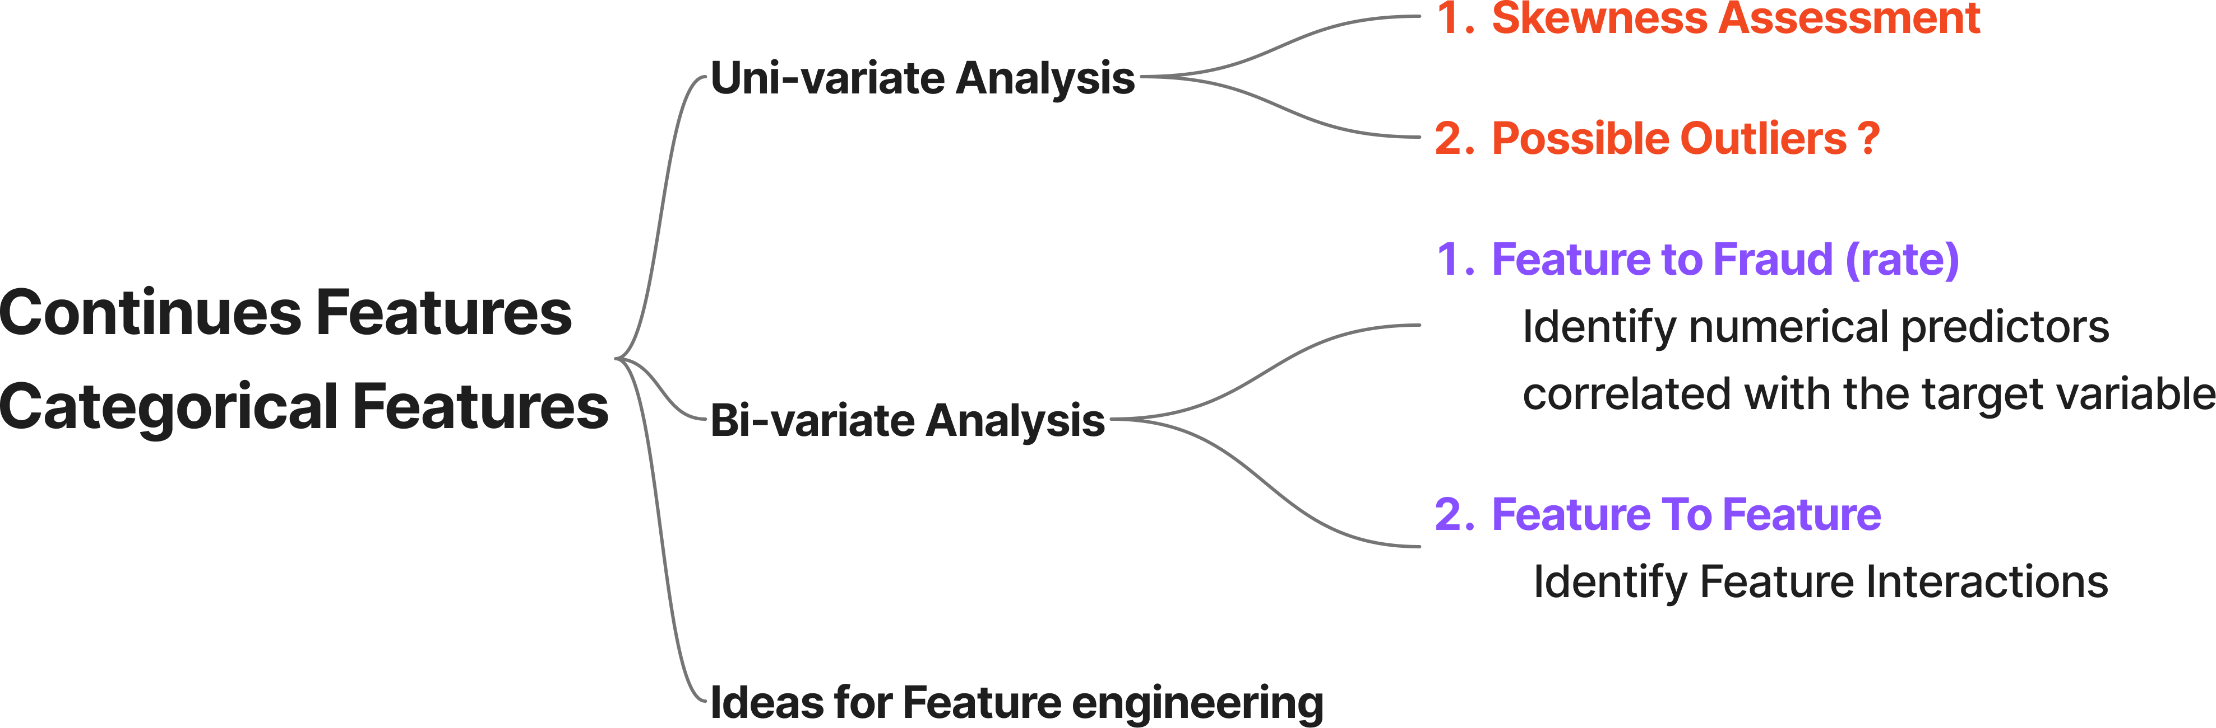
EDA - Methodology
EDA

Slide 6
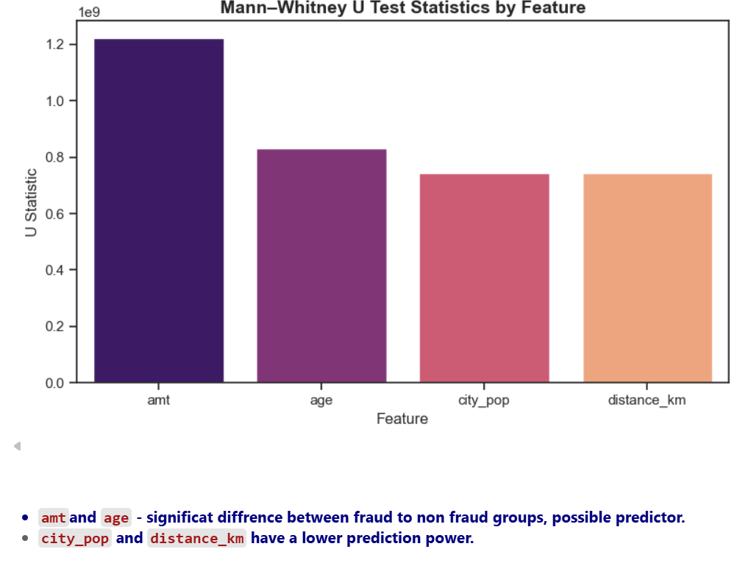
Exploratory Data Analysis (EDA) Insights
Statistical tests (Mann Whitney, Chi Square, Cramer V)
confirmed significance differences across key continues and categorical features:
- Continues To Target :
Amount of transaction
Age
Continues To Continues (Interactions ) :
Insignificant ..

Slide 7
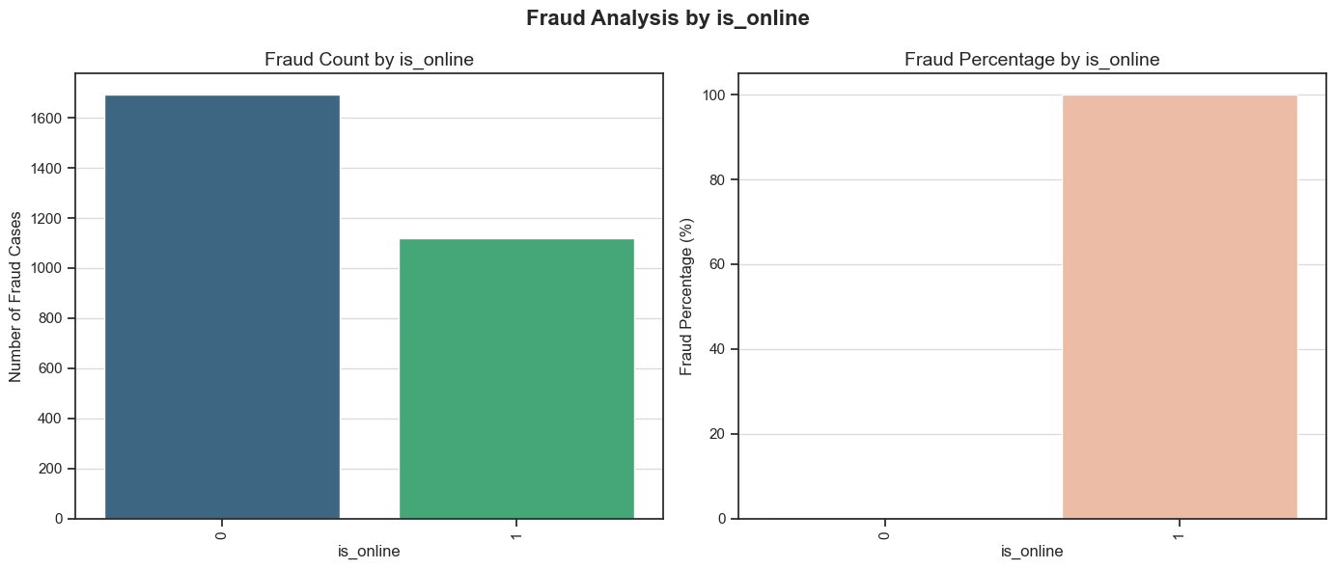
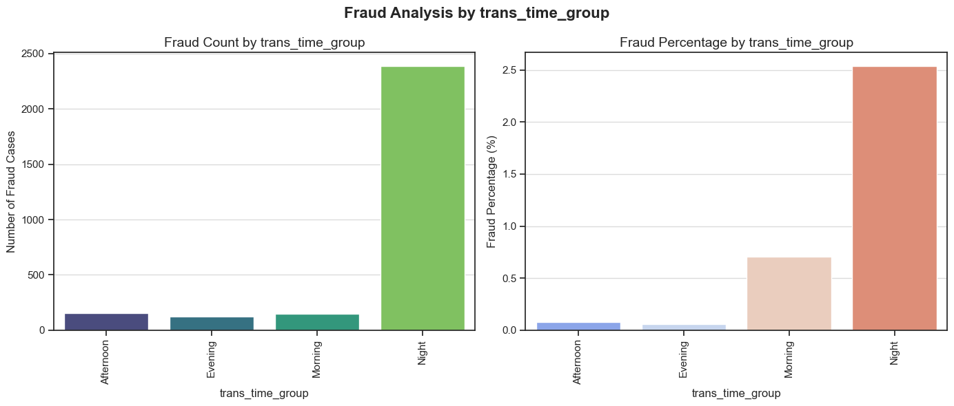
Exploratory Data Analysis (EDA) Insights
Statistical tests (Mann Whitney, Chi Square, Cramer V)
confirmed significance differences across key continues and categorical features:
- Categorical To Target :
Shopping Category
Transaction time related features
Categorical To Categorical (Interactions ) :
Correlation between deduced features
`Category` to `trans_quarter`- totally unexpected..
- Continues To Categorical (variations ) :
Amt across groups ( probably related to skeweness)

Slide 8

Handle Skewness & Outliers
1
2
Skewness
Outliers
transaction amounts were highly skewed.
Log transformation added just as extra evaluation for the linear models.
Outliers in transaction amounts were carefully decided not to cap, since data showed that higher amount ( or binning data) showed possible prediction power.
3
4
Strategic Encoding
Scaling
Categorical variables were converted using one-hot encoding (get_dummies) and label encoding, preparing them for ML algorithms.
Done on split data ( train → transformed the dev and test)

Slide 9
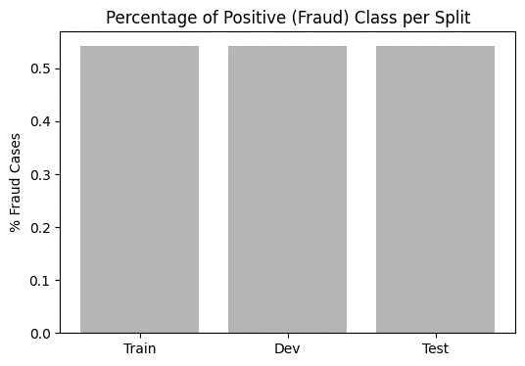
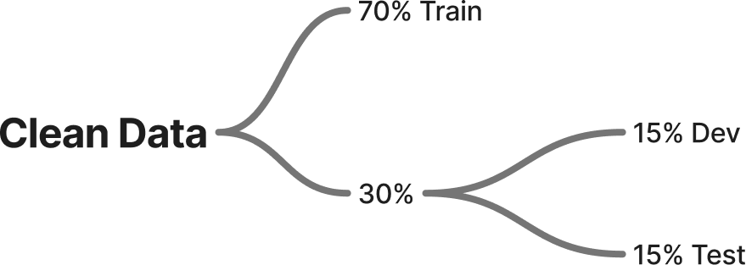
Action Done To Minimize Data Leakage
Avoid enriching data based on aggregated features on the whole data set.
Data Splitting (Before Scaling & Imbalance Handling)
• Scale Fit preprocessing only on training data.
• Prevents Dev/Test information from influencing the model.
• Ensures realistic generalization — no “future data knowledge.”
Separate Validation (Dev) Phase Before Testing
• Model training, feature selection, and tuning done on Train + Dev.
• Test set untouched until final evaluation.
• Maintains unbiased real-world performance estimate and avoids indirect leakage.
Final Retraining on Combined Train + Dev (Before Test)
• Retrain best model on merged Train+Dev to maximize learning.
• Test set used once at the end for final confirmation.
• Provides clean, fair, and reliable evaluation.

Slide 10
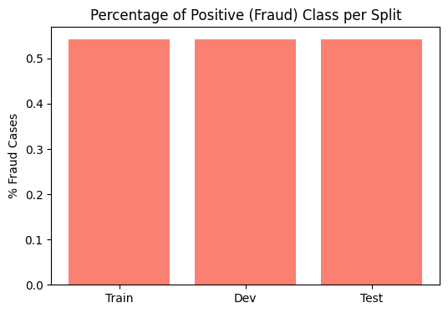
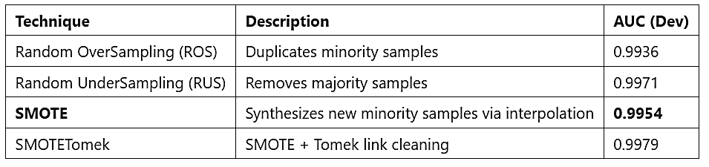
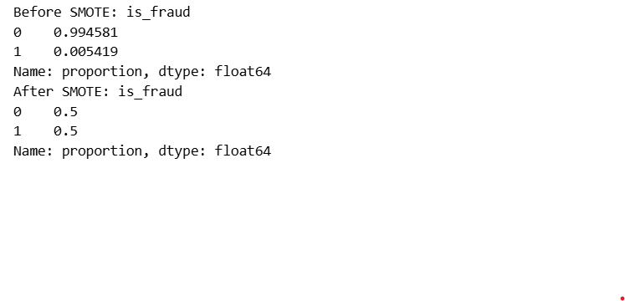
Handling Class Imbalance
Compared 4 resampling strategies to address class imbalance:
Random OverSampling (ROS)
Random UnderSampling (RUS)
SMOTE
SMOTETomek
Final Choice:
SMOTE applied before model training and fine-tuning.
SOMETomek not selected because of slow performance

Slide 11
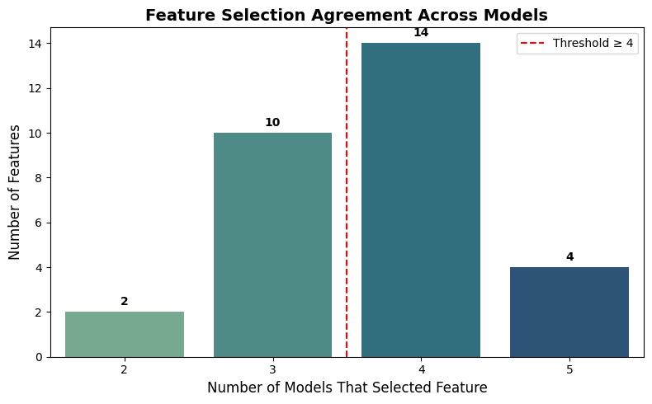
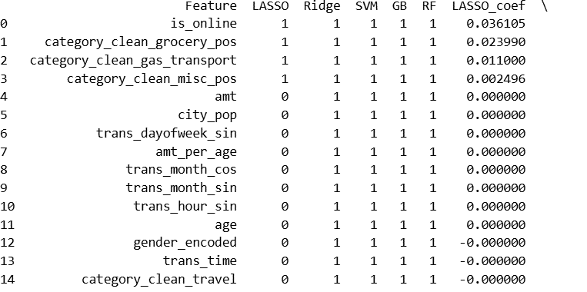
Feature Selection
Initial Feature selection was evaluated on `Train` using
LASSO, Ridge , SVM , GB , RF rankings on the non balanced data
18 features selected for evaluation
- Majority matching the indication seen in EDA

Slide 12
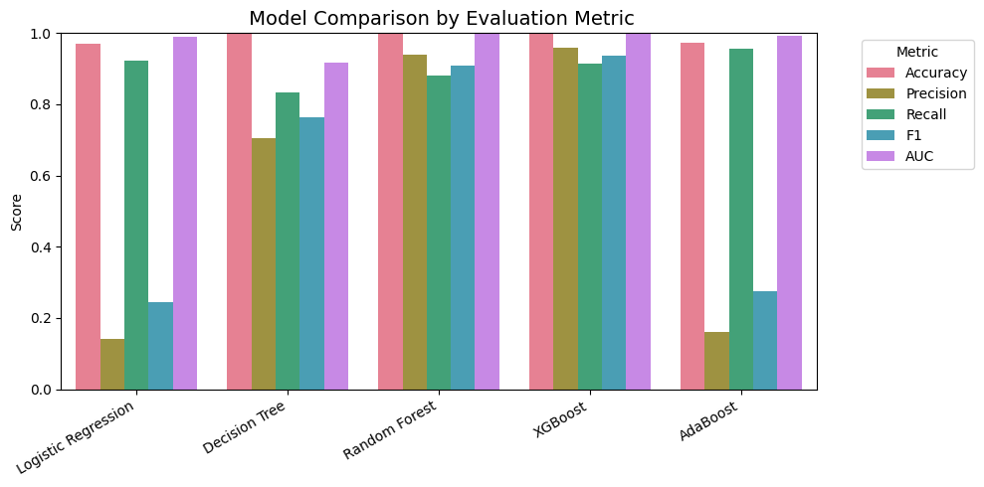
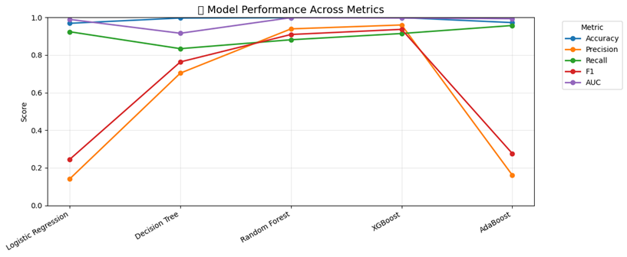
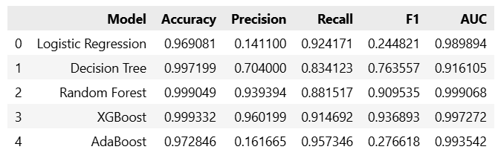
Model Selection & Fine Tuning
XGBoost achieved the best overall F1 and AUC offering a strong trade-off between fraud detection and false positives.

Slide 13
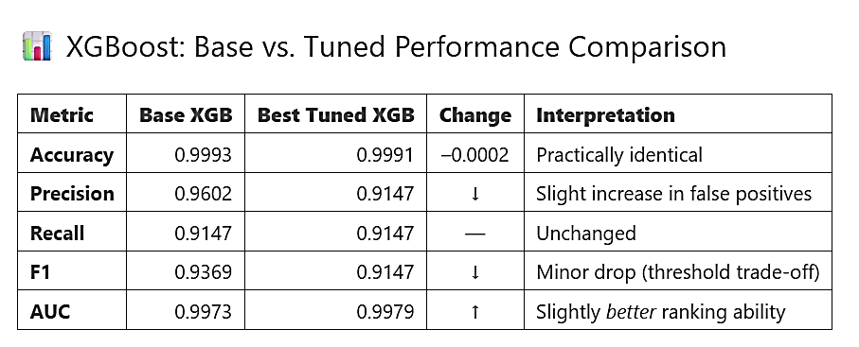
Model Finetuning
Tuning Method: Randomized Search Cross-Validation (RandomizedSearchCV) was used to efficiently search for the optimal combination of hyperparameters.
Continue with Base XGB default hyperparameters.

Slide 14
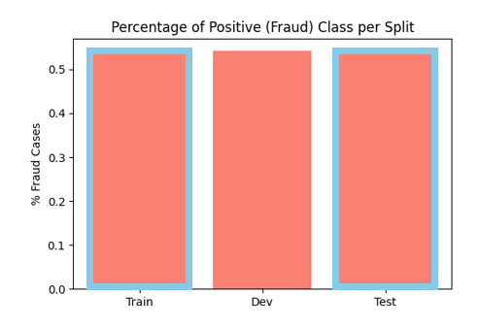
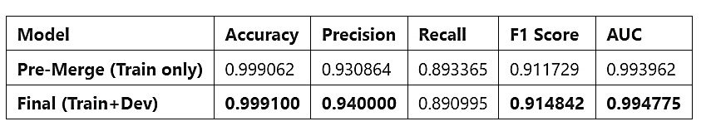
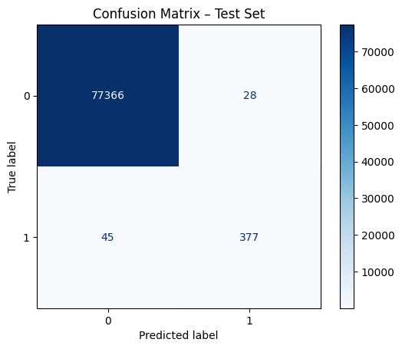
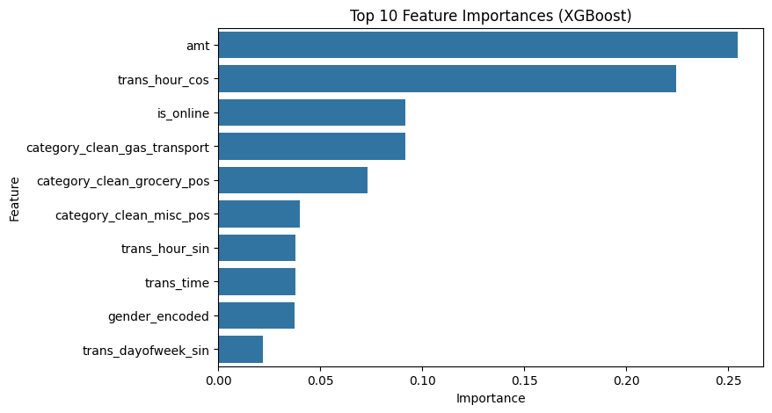
Model Evaluation – XGB (Train → Test)

Slide 15
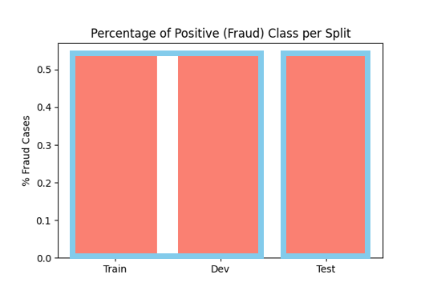
Final Evaluation – XGB (Train +Dev → Test)
Final XGB Model
Retrain on (train+dev)
maximizes the amount of data the final model learns from, potentially increasing its robustness and generalization ability across the known data distributions.

Slide 16
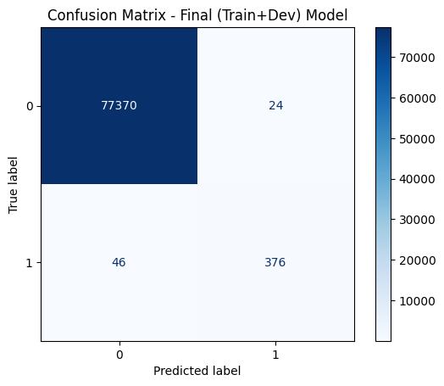
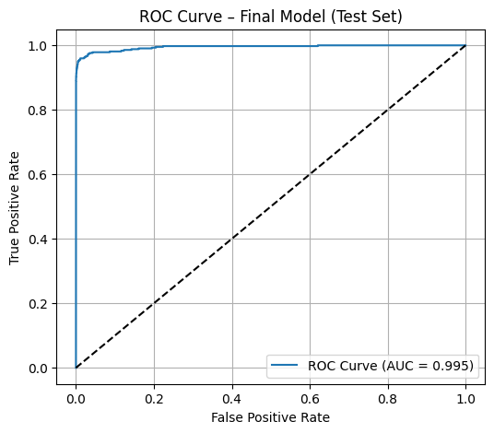
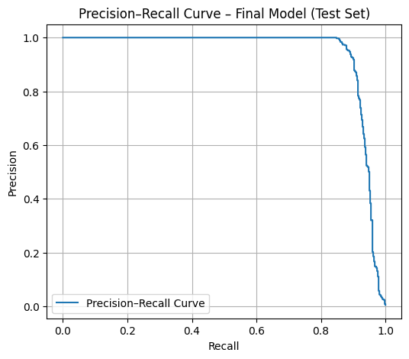
Final Evaluation

Slide 17
Thank You !

